Slide 1

Stage 4 Update
CPSC 481 T01 Group B
TA: Hessam Djavaherpour
Dheeraj Kumar • Gabriella Kenna • Jason Li • Paru Basnet • Zahra Ghavasieh

Slide 2




Project Idea
PotPerfect aims to let users better care for their plants and help users find new plants
Application assists in taking care of plants through reminders and status updates
Application assists in finding new plants through intuitive methods:
Scanning plants through camera
Taking plant-based survey
Searching the apps catalogue

Slide 3
Vertical tasks that were prototyped
Add a new plant to "My Plant List" using the camera
Add a new plant to "My Plant List" by browsing the catalogue
Set up reminders to take care of your plants

Slide 4



Horizontal tasks that were prototyped
Users can view in-depth information about plant species
Users can view each of their plants' current health status
Information about any plant can be viewed from a plant's catalogue entry
Searching the catalogue allows users to find any plant
Plant journals allow users to update their plant's current health status
Use the camera to identify their new plant
Create new reminders for taking care of plants
Edit currently existing reminders for taking care of plants
View journals for their plants to see if they have missed any reminders
Notes:
From "My Plant List", users can view additional information about the plants the currently own, as well as the plant's current health status.

Slide 5

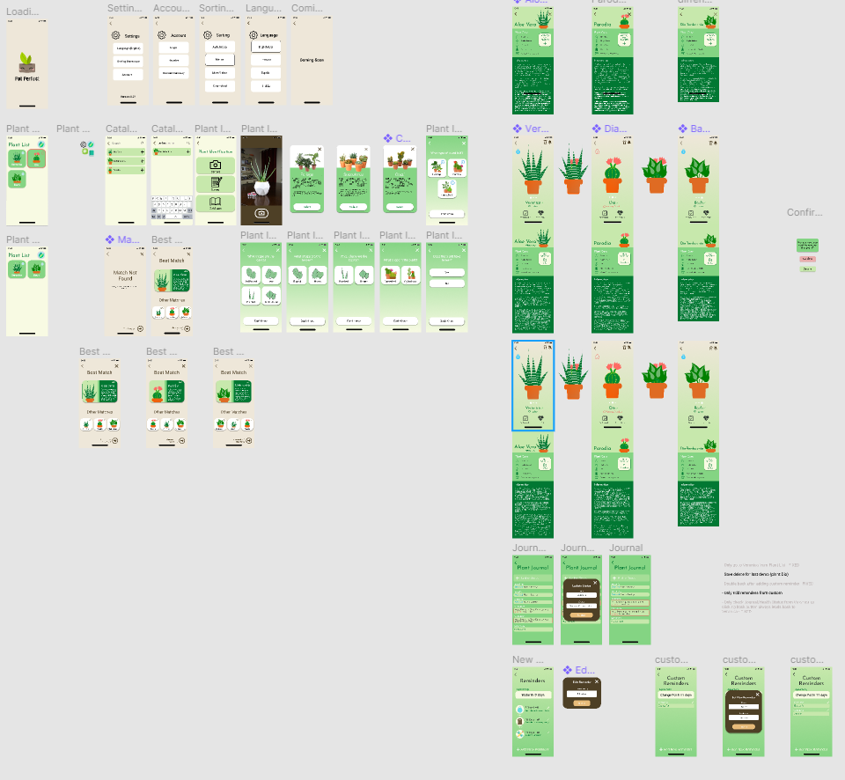
Software used for Hi-fi
The software we used for the Hi-fi was Figma.

Slide 6


Hi-fi Demo

Slide 7



Heuristic Evaluation - Process
Evaluation
Review
Final Report
Notes:
Using our Low-fidelity Prototype and some of our previous sketches, our group created the first draft of the high-fidelity prototype. We then divided the team into 3 evaluators and 2 reviewers.
The evaluators, pretending to only know the general intent of the app, were given the Figma prototype in presentation mode and were asked to interact with it. Then, they each wrote a list of problems they found in the app.
After the evaluators were done, the reviewers then read each evaluation and constructed a table of issues ranked based on their severity and noted possible solutions. Both these processes were done individually.
Finally, our group came together at the end to read the reviews, fix the prototype using the results, and make a final report of which problems were addressed and how they were solved.

Slide 8
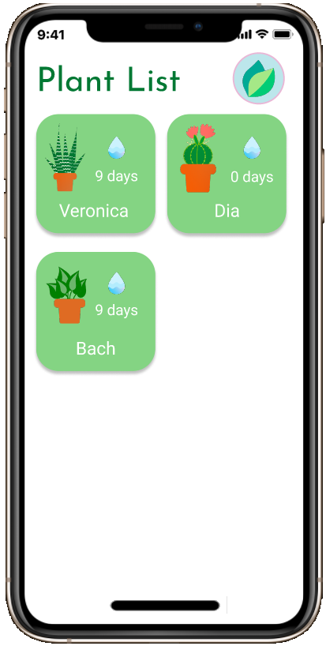
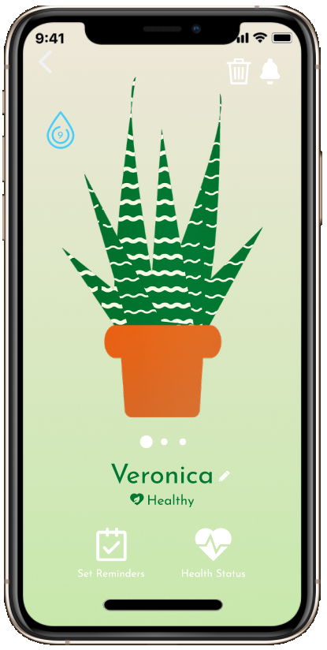
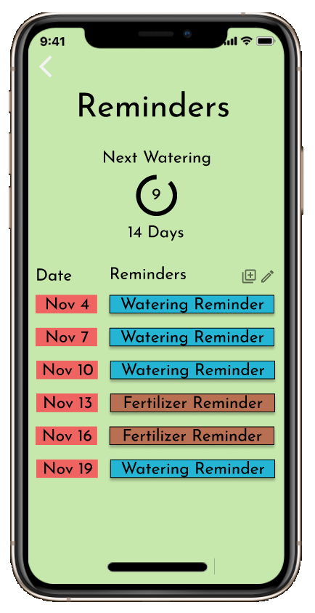
Heuristic Evaluation - Findings
Severity Ranking:
0
Negligible Problems
1
Cosmetic Problems
2
Minor Usability Problems
3
Major Usability Problems
4
Usability Catastrophes
Notes:
We decided to use a 5-ranking system for severity ratings. The problems were ranked 0 to 4 from the negligible problems all the way to usability catastrophes.
Most rank 4 problems included major navigation issues like being unable to escape certain pages or canceling some tasks. These were easily solved by adding back navigation or cancel buttons.
Rank 3 problems were major usability problems and they mostly included things that added confusion for the user such as insufficient or unintuitive icons. For example, the number of days listed in the Plant List items were ambiguous as to whether they meant days left till watering, or the frequency of waterings. Most of these problems had to be solved by rethinking the design.
Minor Usability Problems were ranked 2. These mostly included items that could be clarified but were not overly important for the app to function. Some examples included highlighting plants whose watering was overdue and make them pop out from plants that were in good condition.
Rank 1 issues included cosmetic problems like being unable to read white texts on light backgrounds or clashing colour palettes.
And finally, rank 0 problems were those that were either subjective or those that couldn’t be fixed in a Figma prototype. Some examples included adding notification popups or unnecessarily adding extra information for all plant survey choices.

Slide 9

Heuristic Evaluation -Application -
Notes:
Once the reviews were complete, we organized a larger group work session, where we took the time to review the changes needed and implement them together. By doing this collaboratively, it was easier to make sure new updates were consistent and breaking changes were caught and handled promptly. This process was further streamlined by having one group member in charge of navigation issues and one group member in charge of theming decisions.
While most pages saw colouring updates to create a more consistent theme, a few pages underwent larger updates.

Slide 10
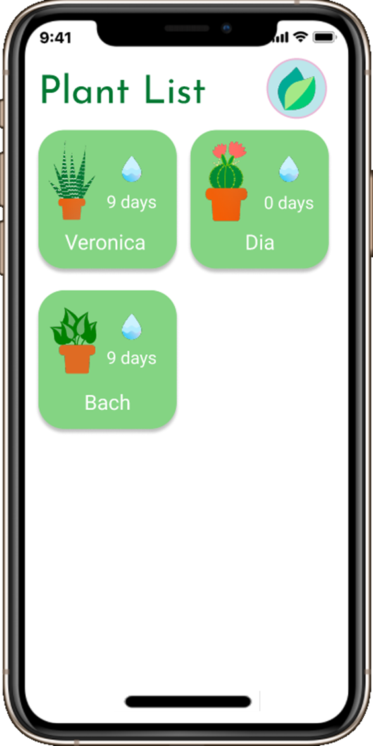
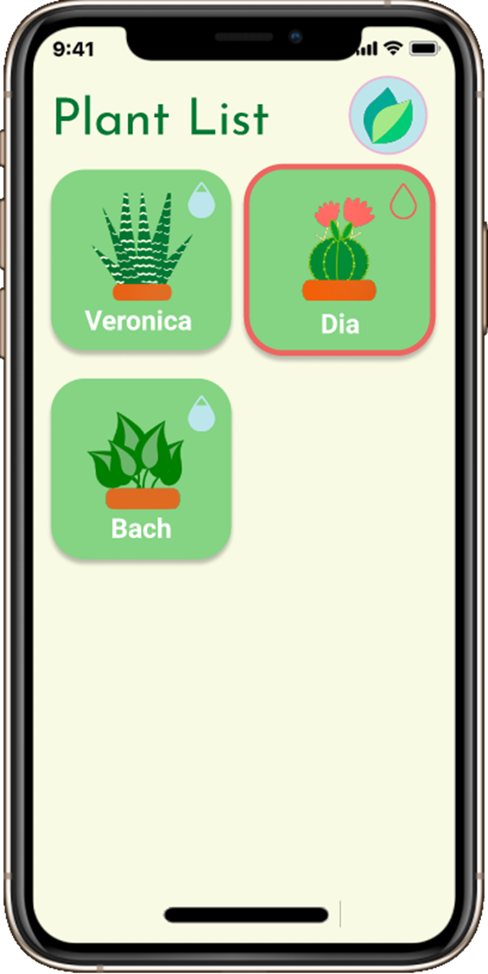
Before & After
Notes:
One of these pages was the plant list page. As the first page users see, we really wanted to ensure that the focus was clear and that users could quickly pick out information that was most important to them. A lot more focus was given to plant images and names, in order to make it easier for users to skim and find their plant. Plants needing care were also highlighted to bring them to the users attention.

Slide 11
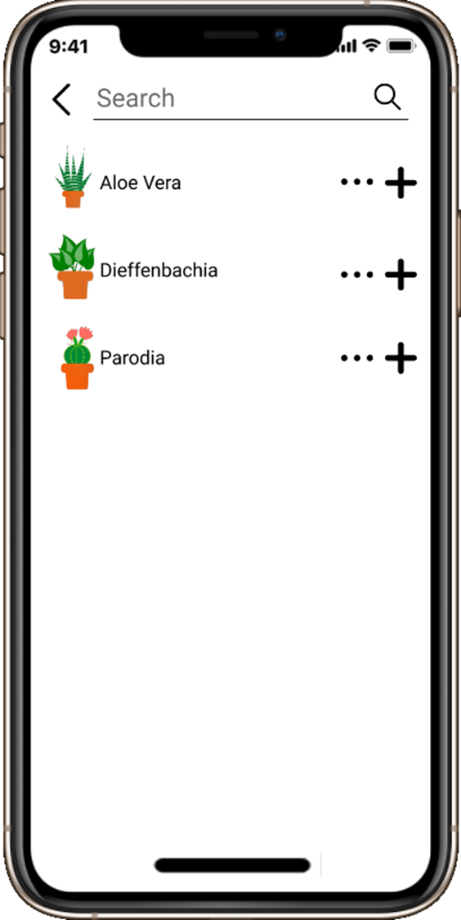
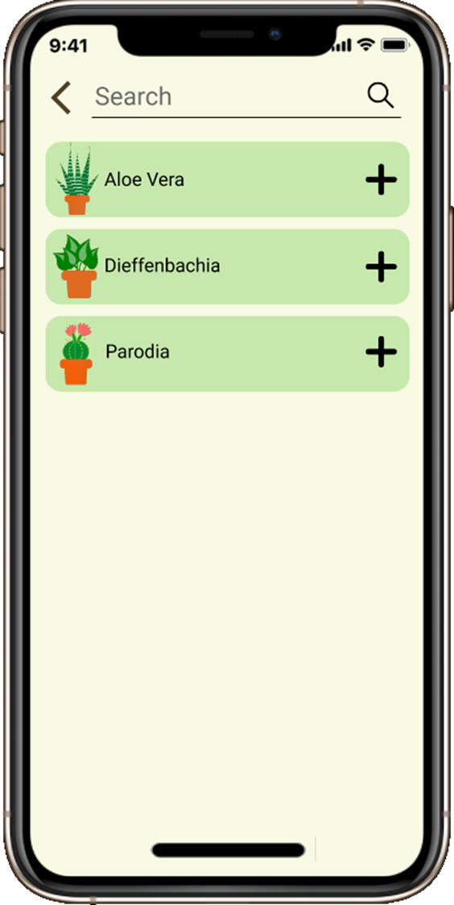
Before & After
Notes:
The plant catalogue and search page was also updated. To draw greater attention to the idea that any result row can be clicked for more information, results were updated to look more like a clickable button and the … button that had previously also led to more info was removed, as it confused evaluators and was no longer needed.

Slide 12
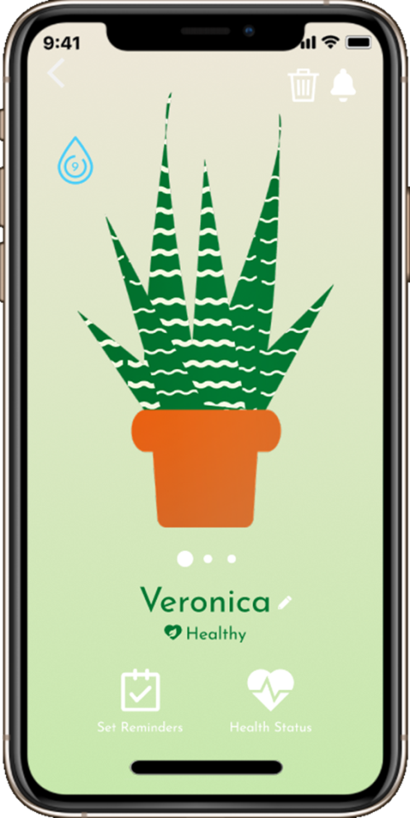
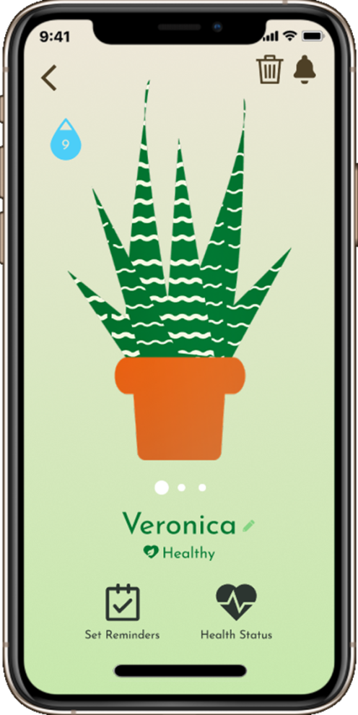
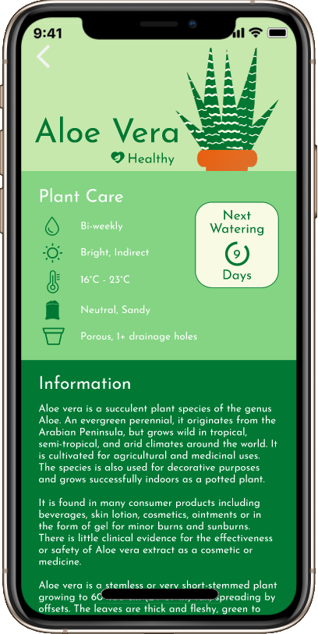
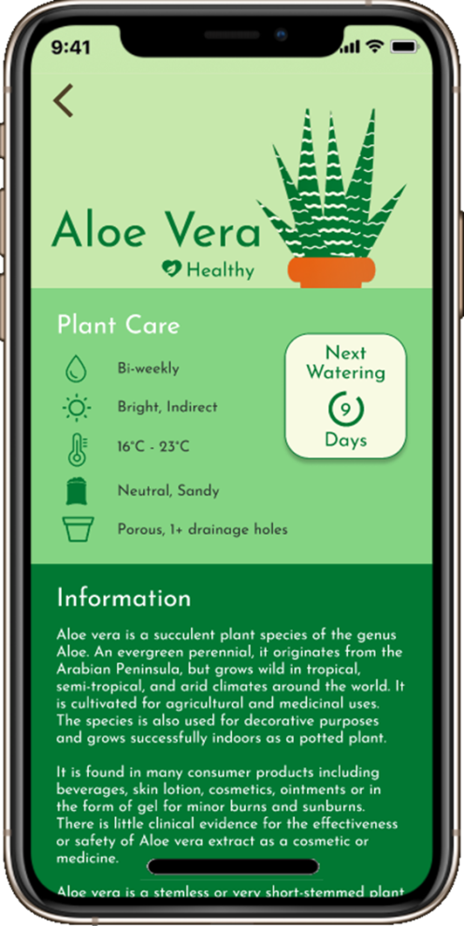
Before & After
Notes:
The user plant info page saw more minor updates. The main issues evaluators had were in legibility, so white text and icons were darkened to allow for better reading and visibility. The watering icon was also updated to be consistent with the new plant list items.

Slide 13
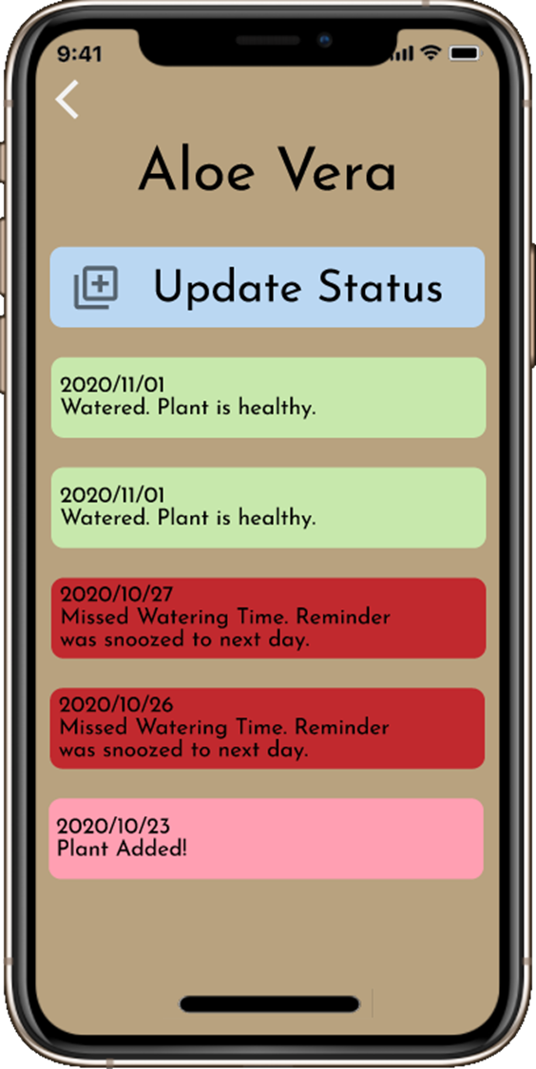
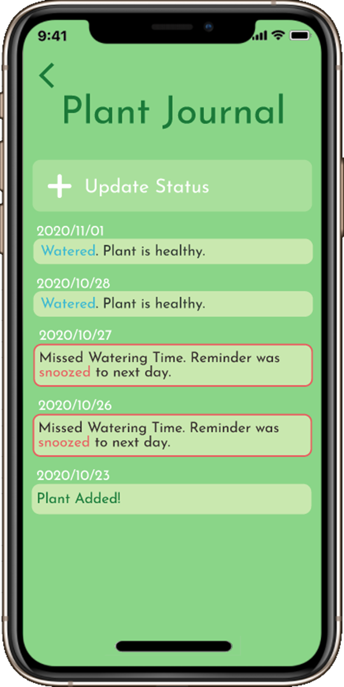
Before & After
Notes:
Similarly, the plant journal, while not seeing many changes in layout saw the most theming changes.

Slide 14
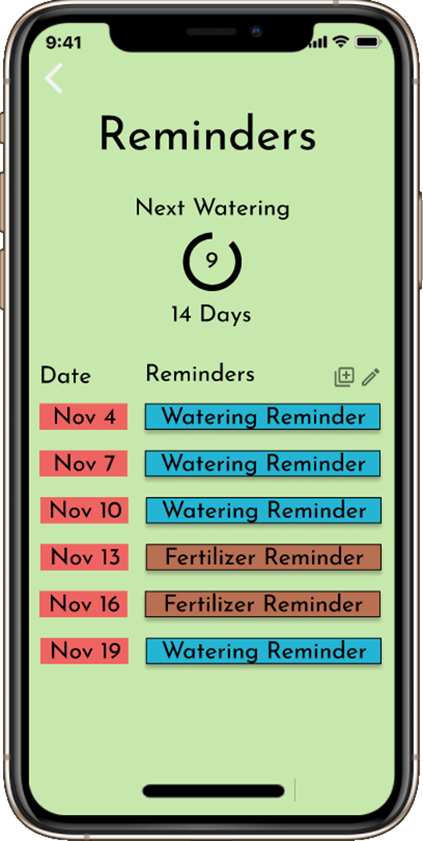
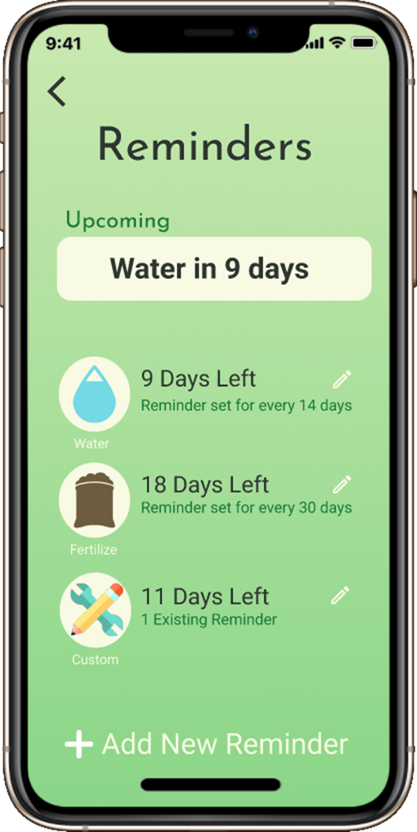
Before & After
Notes:
Of the pages, the reminders page saw the most changes. Evaluators had trouble understanding how to read and use the page, leading to a redesign of the page. The goals of this redesign were to make information as simple but explicit as possible as well as making it as clear as possible what changes they could make.

Slide 15




Plans for final Stage
Implement solutions to some of the problems with non-critical severity rankings.
Refine application design and aesthetics.
Implement suggestions and fix problems from stage 4 evaluation.

